Slide 1



A Pinch of Salt
A Seasoned Introduction to Automating with SaltStack
Notes:
SaltStack Logo property of Salt Project (SaltStack Inc)
Salt Shaker icon created by Sumitsaengtong on Flaticon.com (https://www.flaticon.com/free-icon/salt-shaker_7318113?related_id=7318113&origin=tag)
Digital Magnifying Glass property of Corey Forman (reproduction or unauthorized use prohibited – permission provided by author for this presentation only).

Slide 2
About Me – Corey Forman
In DFIR field for 20+ years
Senior Computer Forensic Analyst – Canada Revenue Agency
Spent 17 years in the Canadian Armed Forces, the last 7 of which as one of DND’s first-ever Cyber Operators, running the Forensics team
SANS Subject Matter Expert
Instructor at Canadian Police College (CMPFOR)
Contributor to SANS SIFT Workstation, and REMnux Malware Analysis toolkit
Creator of a few forensics tools
github.com/digitalsleuth
Notes:
Reach me on Github – https://github.com/digitalsleuth

Slide 3
What is SaltStack (Salt)?
Table Salt, Sodium, NaCl
Robust automation and infrastructure management platform
Remote execution, provisioning, orchestration
Platform and OS agnostic (Servers, IOT, Networks)
Uses agents (master and minions)
Based on Python 3.x, YAML (Yet Another Markup Language), and Jinja
Open Source!
Notes:
Python – https://www.python.org
YAML - https://en.wikipedia.org/wiki/YAML
Jinja - https://jinja.palletsprojects.com/en/3.1.x/intro/
Salt on Github - https://github.com/saltstack/salt

Slide 4
What Can It Do?
Remote management of a single system or full domain
Execute applications
Configuration management
Install or remove software
LDAP and Active Directory Integration
Reporting and Scheduling of Tasks
Network Device Management

Slide 5
How It Works
The “salt-master” service is run on a server of your choosing
The “salt-minion” service is run on the devices you wish to manage, or the system can be ‘agentless’ by use of a proxy. The minion can also act as a stand-alone system, and execute commands.
A “state” file is created using YAML and Jinja and placed in the appropriate location on the server (or stand-alone minion) for execution
A command is run on the master (or stand-alone minion) to initiate the “state” on the target system
Command is run

Slide 6
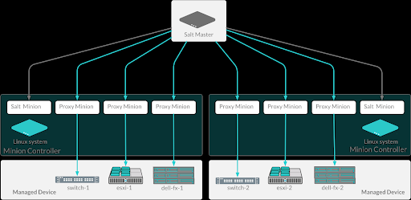
How It Works
Notes:
Image Source - https://docs.saltproject.io/salt/user-guide/en/latest/_images/master-minion-flow.png

Slide 7
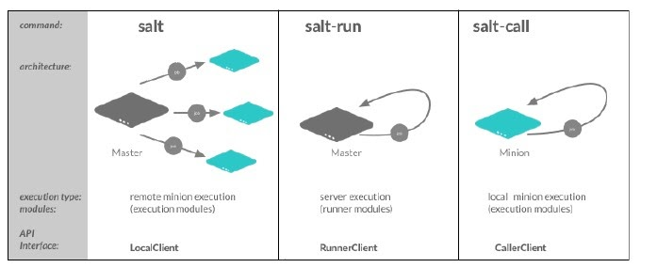
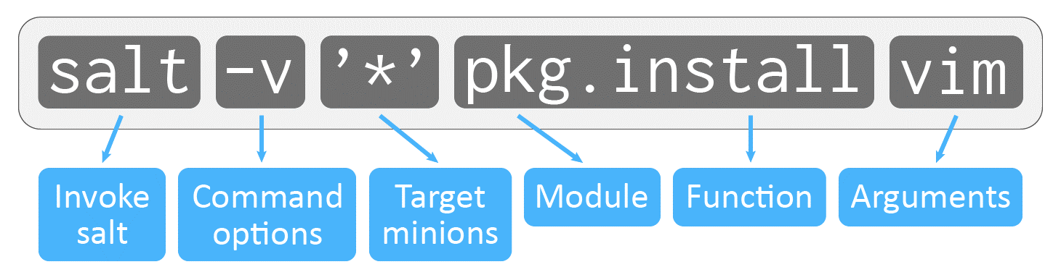
How It Works
Notes:
Image Sources
https://docs.saltproject.io/salt/user-guide/en/latest/_images/salt-execution-types.jpg
https://docs.saltproject.io/salt/user-guide/en/latest/_images/salt-command.png

Slide 8
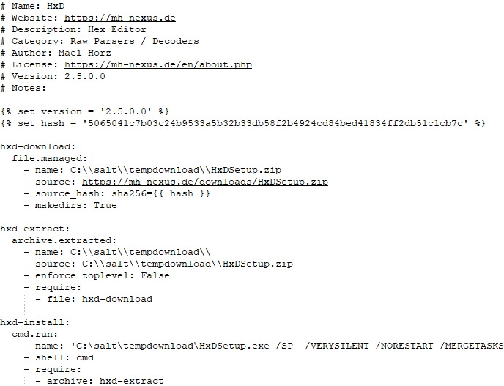
How It Works – YAML and Jinja
Notes:
Screenshot Source - https://github.com/digitalsleuth/winfor-salt/blob/main/winfor/installers/hxd.sls

Slide 9
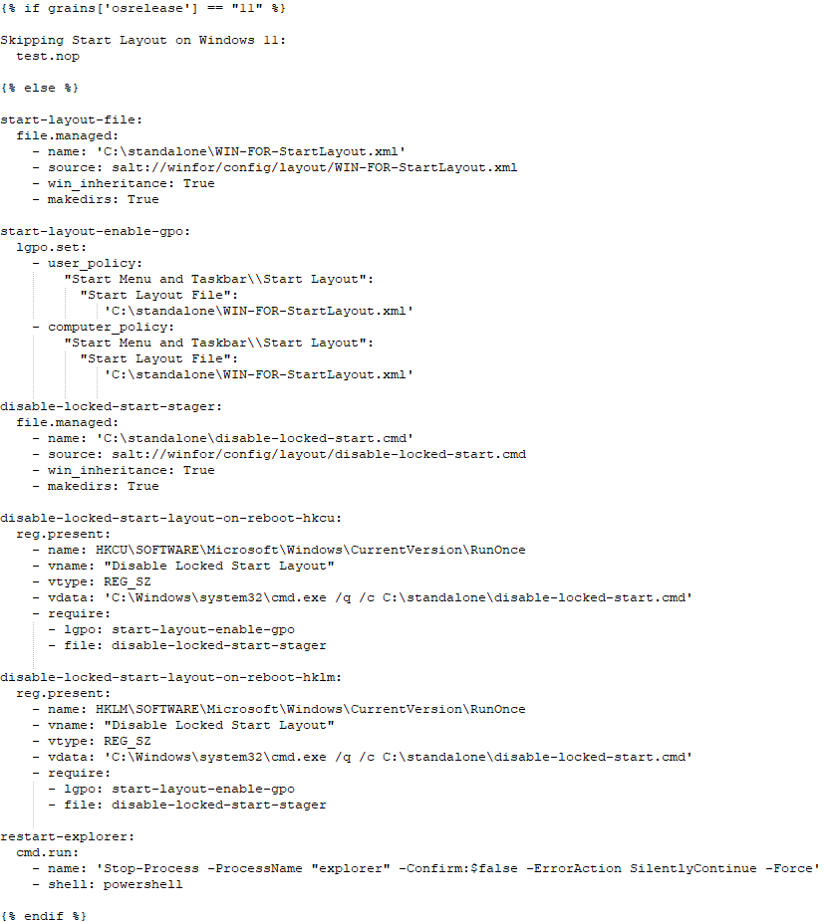
How It Works – YAML and Jinja
Notes:
Screenshot Source - https://github.com/digitalsleuth/winfor-salt/blob/main/winfor/config/layout/init.sls

Slide 10
How You Can Use It
Automate the installation and maintenance of a forensic workstation
SIFT, REMnux, m.a.t. (Mobile Analysis Toolkit), WIN-FOR (Windows Forensics Installer)
Automate the execution of commands on forensic acquisitions
Run a single command to start the triage of multiple pieces of evidence, including hashing, data extractions
Run triage applications on evidence items and copy the results to a specific location
Alert when an activity is complete
Schedule the query of new version downloads for software
Do all of this with one simple command!
Notes:
SIFT Workstation - https://www.sans.org/tools/sift-workstation/
REMnux - https://remnux.org/
m.a.t. - https://github.com/digitalsleuth/mat-salt/
WIN-FOR – https://github.com/digitalsleuth/winfor-salt/

Slide 11
Usage Example: Automating Installs - WIN-FOR

Slide 12
Live Example: Automating Triage

Slide 13
In Closing
SaltStack is an excellent tool for automation
Installs on nearly every operating system
Relatively easy to learn
Scriptable – Since it’s Python-based, it has modules which can be used in your own scripts!
The WIN-FOR (Windows Forensics) installer and the m.a.t. installer (Mobile Analysis Toolkit) can be found at https://github.com/digitalsleuth/WIN-FOR and https://github.com/digitalsleuth/mat-salt
corey[at]digitalsleuth[dot]ca

Slide 14
Questions?
Notes:
SaltStack Logo property of Salt Project (SaltStack Inc)
Salt Shaker icon created by Sumitsaengtong on Flaticon.com (https://www.flaticon.com/free-icon/salt-shaker_7318113?related_id=7318113&origin=tag)
Digital Magnifying Glass property of Corey Forman (reproduction or unauthorized use prohibited – permission provided by author for this presentation only).

